Slide 1

Chapter 2 ~ BASIC RELATIONSHIP BETWEEN PIXELS
Created By
S. M. Mahedy Hasan Assistant Professor, Dept. of CSE RUET, Rajshahi-6204, Bangladesh.
Modified by
Md. Manirujjaman
Lecturer, Dept. of CSE
DIU, Satarkul, Badda, Dhaka

Slide 2


Neighbors of a pixel
x
 |  | (x,y-1)
 | (x-1,y) | p(x,y) | (x+1,y)
 |  | (x,y+1)
y

Slide 3
Neighbors of a Pixel
The four diagonal neighbors of p at coordinates (x, y) is denoted by N_{D}(p).
x
 | (x-1,y-1) |  | (x+1,y-1)
 |  | p(x,y)
 | (x-1,y+1) |  | (x+1,y+1)
y

Slide 4
Neighbors of a Pixel
The 8-neighbors of p at coordinates (x,y), denoted by N₈(p).
x
 | (x-1,y-1) | (x,y-1) | (x+1,y-1)
 | (x-1,y) | p(x,y) | (x+1,y)
 | (x-1,y+1) | (x,y+1) | (x+1,y+1)
y

Slide 5
Adjacency
Two pixels are adjacent if they are neighbors and their intensity level ‘V’ satisfy some specific criteria of similarity.
Let V be the set of intensity values used to define adjacency.
Binary Image : V⊂{0,1}
Gray Image : V ⊂{0,1,2, …, 255}
In binary images, 2 pixels are adjacent if they are neighbors & have some intensity values either
0 or 1.

Slide 6
Adjacency
Three types of adjacency:
4-adjacency: Two pixels p and q with the values from set ‘V’ are 4-adjacent if q is in the set of N4(p).
For example, V = { 0, 1}
1 | 1 | 0
1 | 1 | 0
1 | 0 | 1
Here, p in RED color q can be any value in GREEN color.

Slide 7
Adjacency
Three types of adjacency:
8-adjacency: Two pixels p and q with the values from set ‘V’ are 8-adjacent if q is in the set of
N₈(p).
For example, V = { 1, 2}
0 | 1 | 1
0 | 2 | 0
0 | 0 | 1
p in RED color and q can be any value in GREEN color.

Slide 8
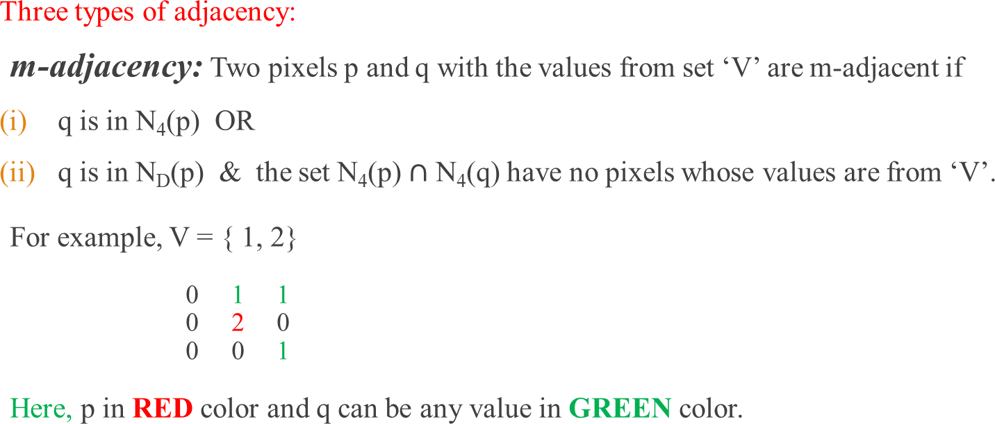
Adjacency

Slide 9
Adjacency
m-adjacency: Two pixels p and q with the values from set ‘V’ are m-adjacent if
(i) q is in N₄(p)
For example, V = { 1 }
(i) b & c
0 a | 1 b | 1 c
0 d | 1 e | 0 f
0 g | 0 h | 1 I
Solution: b & c are m-adjacent.

Slide 10
Adjacency
m-adjacency: Two pixels p and q with the values from set ‘V’ are m-adjacent if
q is in N₄(p)
For example, V = { 1 }
b & e
0 a | 1 b | 1 c
0 d | 1 e | 0 f
0 g | 0 h | 1 I
Solution: b & e are m-adjacent.

Slide 11
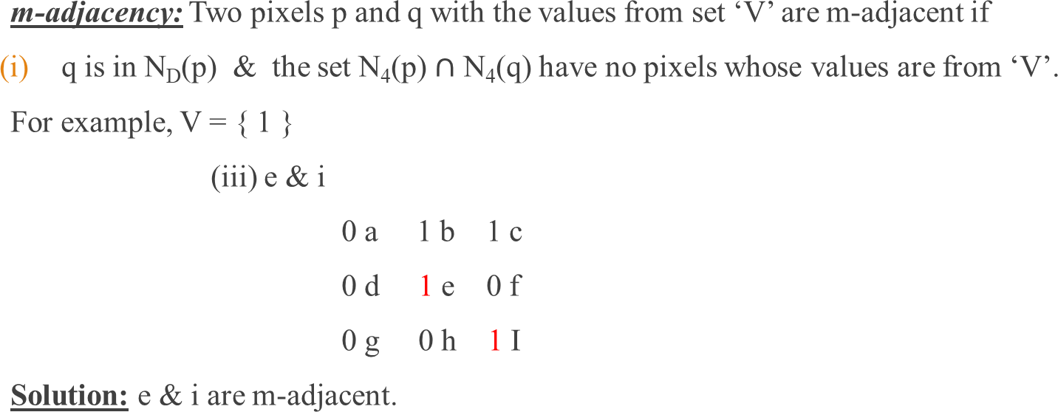
Adjacency

Slide 12
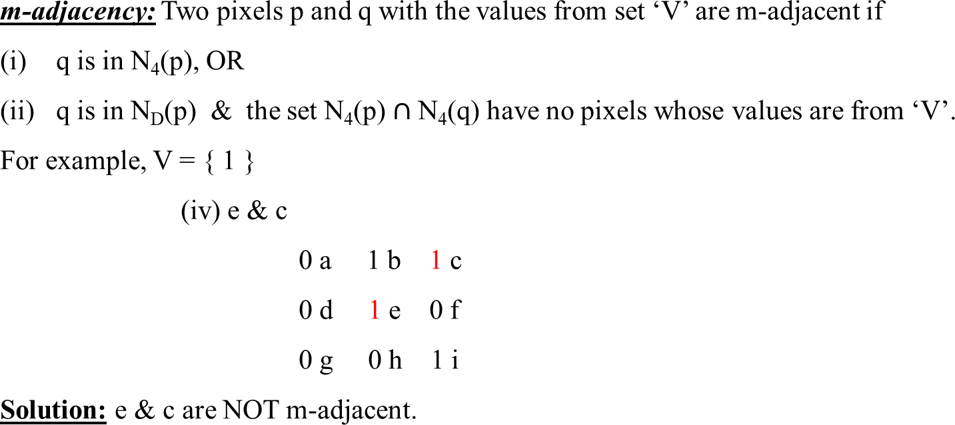
Adjacency

Slide 13
Connectivity
We need to find connectivity between two pixels to determine whether they belong to the same region or object in an image.
Connectivity helps in:
Identifying objects or regions (grouping pixels with similar properties).
Detecting boundaries and separating objects from the background.
Performing region-based operations, such as labeling, segmentation, and counting objects.

Slide 14
Connectivity
Two pixels are said to be connected:
If they are adjacent in some sense (neighbor pixels, 4/8/m-adjacency)
If their gray levels satisfy a specified criterion of similarity (equal intensity level)
There are three types of connectivity on the basis of adjacency:
4-connectivity: Two or more pixels are said to be 4-connected if they are 4-adjacent with each others.
8-connectivity: Two or more pixels are said to be 8-connected if they are 8-adjacent with each others.
m-connectivity: Two or more pixels are said to be m-connected if they are m-adjacent with each others.

Slide 15
Paths
Example # 1: Consider the image segment shown in figure. Compute length of the shortest-4, shortest-8 & shortest-m paths between pixels p & q where, V = {1, 2}.
4 | 2 | 3 | 2 q
3 | 3 | 1 | 3
2 | 3 | 2 | 2
p 2 | 1 | 2 | 3

Slide 16
Paths
Example # 1: Shortest 4-Path does not exist.
4 | 2 | 3 | 2 q
3 | 3 | 1 | 3
2 | 3 | 2 | 2
2 p | 1 | 2 | 3

Slide 17
Paths
Example # 1: Shortest 8-Path = 4.
4 | 2 | 3 | 2 q
3 | 3 | 1 | 3
2 | 3 | 2 | 2
2 p | 1 | 2 | 3

Slide 18
Paths
Example # 1: Shortest m-Path = 5.
4 | 2 | 3 | 2 q
3 | 3 | 1 | 3
2 | 3 | 2 | 2
2 p | 1 | 2 | 3

Slide 19
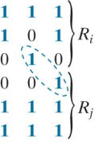
Regions
A region in an image is a group of connected pixels with similar properties.
Let R be a subset of pixels in an image. We call R a region of the image if R is a connected set.
Regions that are not adjacent are said to be disjoint.
Two regions (of 1s) that are adjacent if 8-adjecency is used.

Slide 20
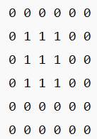

Boundary
Set of pixels in the region that have one or more neighbors that are not in R.
The boundary (also called the border or contour) of a region R is the set of pixels in R that are adjacent to
pixels in the complement of R.
Stated another way, the border of a region is the set of pixels in the region that have at least one background neighbor.

Slide 21
Boundary
If R happens to be an entire image (which we recall is a rectangular set of pixels), then its boundary is defined as the set of pixels in the first and last rows and columns of the image.
This extra definition is required because an image has no neighbors beyond its border.
1 | 1 | 1 |  | 1
1 | 1 | 1 |  | 1
1 | 1 | 1 |  | 1
1 | 1 | 1 |  | 1

Slide 22
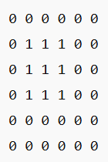
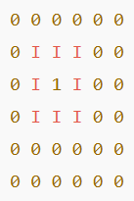
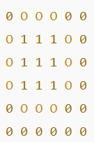
Boundary
In digital image processing, boundaries of a region can be further classified as:
Inner Boundary: Pixels inside the region that are adjacent to at least one background pixel.
Outer Boundary: Pixels outside the region (background pixels) that are adjacent to at least one pixel of the region.
Inner boundary
The region is the 3×3 block of 1’s in the center.
Outer boundary

Slide 23
Applications of Finding Boundary
Object Detection: Used to detect and recognize objects in an image based on their outer shape.
Image Segmentation: Helps to separate an object from the background or divide an image into meaningful regions.
Shape Analysis: Used to measure the area, perimeter, and structure of objects for further study.
Edge Detection: Boundaries are used in edge detection algorithms like Sobel or Canny to highlight object outlines.
Robotics and Navigation: Helps robots or autonomous vehicles identify obstacles and pathways.

Slide 24
Distance Measures
For pixels p(x, y), q(s, t) and z(u, v), D is a distance function or metric if
D(p, q) ≥ 0
(D(p, q) = 0, if p = q)
D(p, q) = D(q, p)
D(p, z) ≤ D(p, q) + D(q, z)
 | p(x, y)
z(u, v) |  |  |  | q(s, t)
Notes:
In digital image processing, a distance measure is used to calculate how far one pixel is from another pixel (or one region from another). It helps in comparing positions, detecting similarity, and grouping pixels based on closeness.

Slide 25
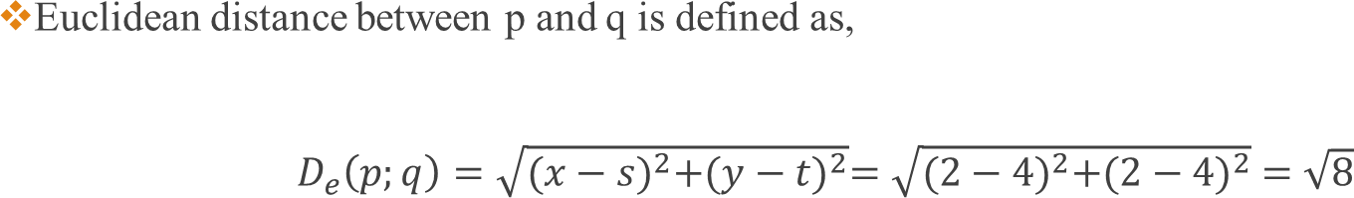
Euclidean Distance
 | P(x, y)
 |  |  | q(s, t)

Slide 26
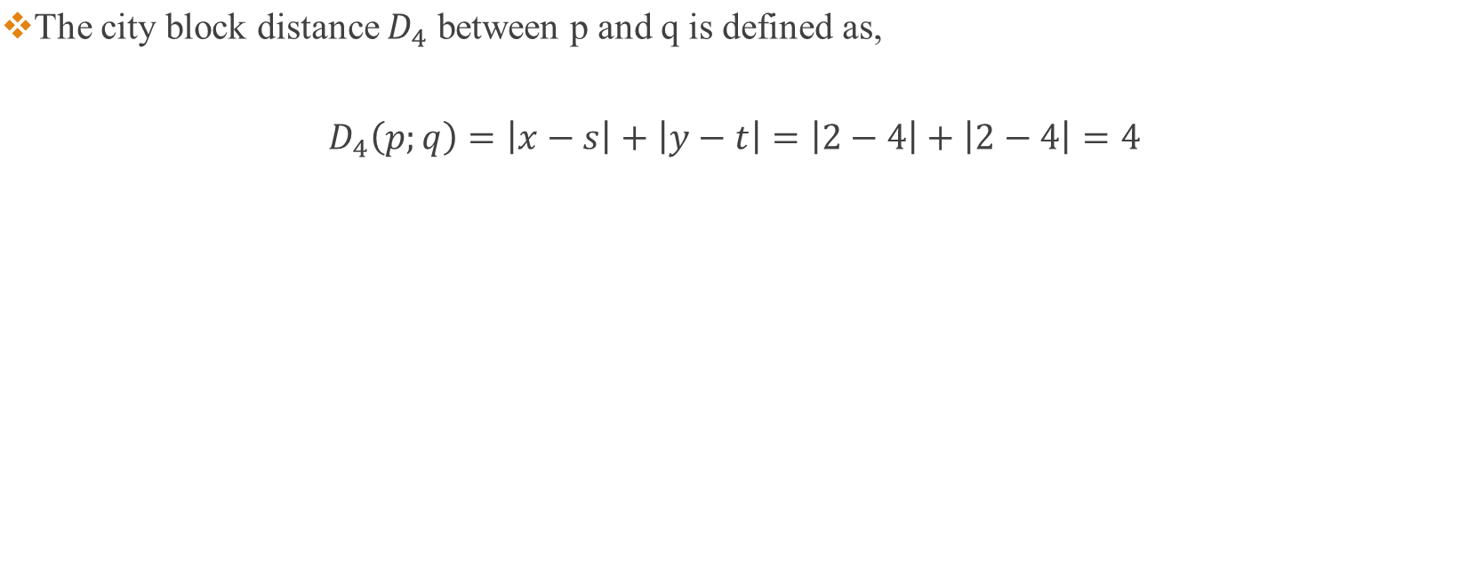
City Block Distance
 | P(x, y)
 |  |  | q(s, t)

Slide 27
City Block Distance
?? | ?? | 2 | ?? | =??
?? | 2 | 1 | 2 | ??
2 | 1 | 0 | 1 | 2
?? | 2 | 1 | 2 | ??
?? | ?? | 2 | ?? | ??

Slide 28
City Block Distance
4 | 3 | 2 | 3 | 4
3 | 2 | 1 | 2 | 3
2 | 1 | 0 | 1 | 2
3 | 2 | 1 | 2 | 3
4 | 3 | 2 | 3 | 4

Slide 29
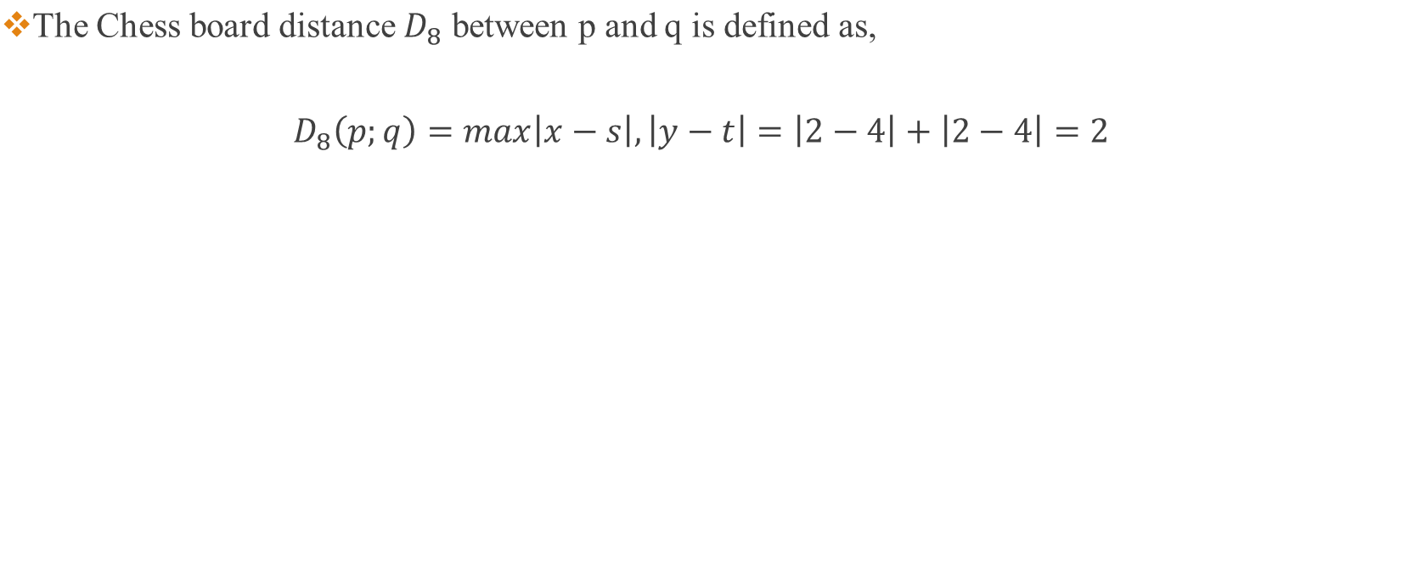
Chess Board Distance
 | P(x, y)
 |  |  | q(s, t)

Slide 30
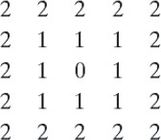
Chess Board Distance

Slide 31
Thank You ☺

